Slide 1
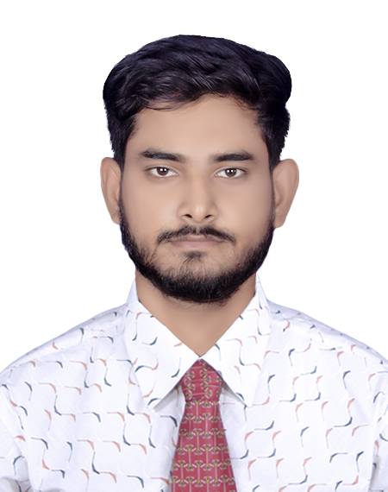
SHAHIL AHEMMED

Slide 2
CONTACT
Phone: +880 1869916055
Email: shahilahmd2020@gmail.com
Permanent Address: Dhanua, Sreepur, Gazipur
Present Address: House: 32, Road:9/E, Block: D, Sector: 05, Uttara Dhaka 1230

Slide 3
WORK EXPERIENCE
I have 1 year experience teaching computer program at “FAHIM COMPUTER TRAINING CENTER”.
I have 1 year CPA marketing experience in “Nation IT Ltd”.
I have 1 years volunteer work experience in IHRS club at “Independent University, Bangladesh”
I have 2 years of experience in marketing on online platforms.

Slide 4
EXTRACURRICULAR ACTIVITIES/ SKILLS:
Participated in a Global HR competition organized in “OVER THE WALL” 2023.
I have a skills on "Effective Leadership" from veritas academy

Slide 5
EDUCATION
I'm still studying in BBA Department (Independent University, Bangladesh)
Higher Secondary Certificate, (Kazi Azim Uddin College) 2020 Cgpa: 4.92
Secondary School Certificate, (Dhanua High School) 2018 Cgpa: 4.61

Slide 6
SKILLS
Team Work
Time Management
Leadership
Microsoft Excel, PowerPoint, Google Forms, GitHub
Communication

Slide 7
LANGUAGE
Bangla
English
French (Basic)
Hindi

Slide 8
The end

